Slide 1
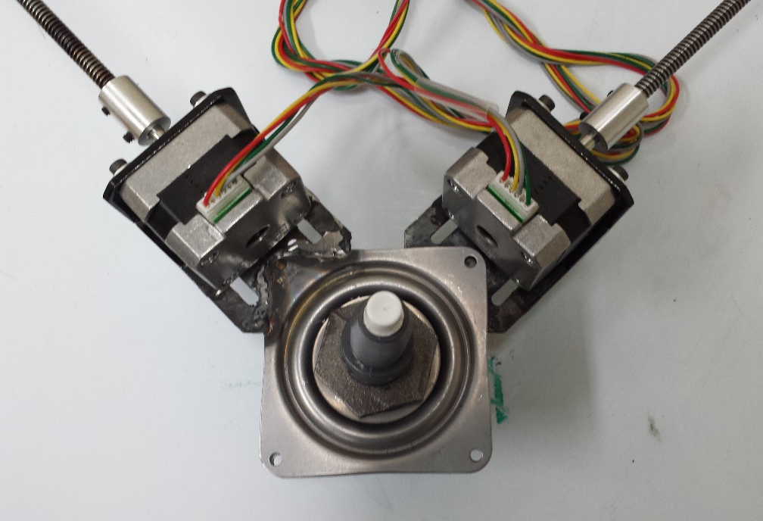
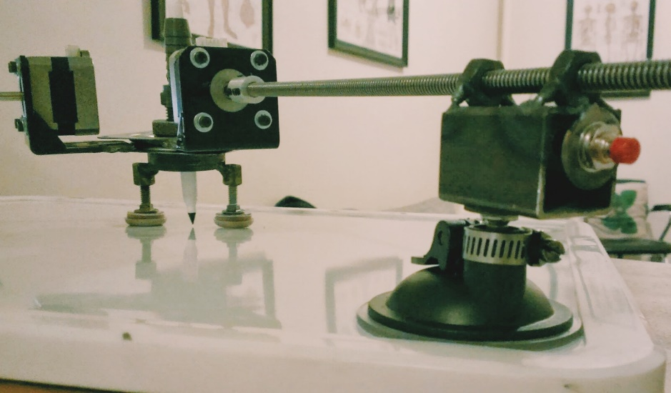
ME 5643|Mechatronics Project Proposal: CNC Plasma Cutter Proof of Concept
Andy Lynch, Rajiv Panday, Stephen Carter
NYU Polytechnic School of Engineering
December 01, 2014
Professor SangHoon Lee

Slide 2
BAILEIGH Plasma table pt-22 - $4,495.00

Slide 3
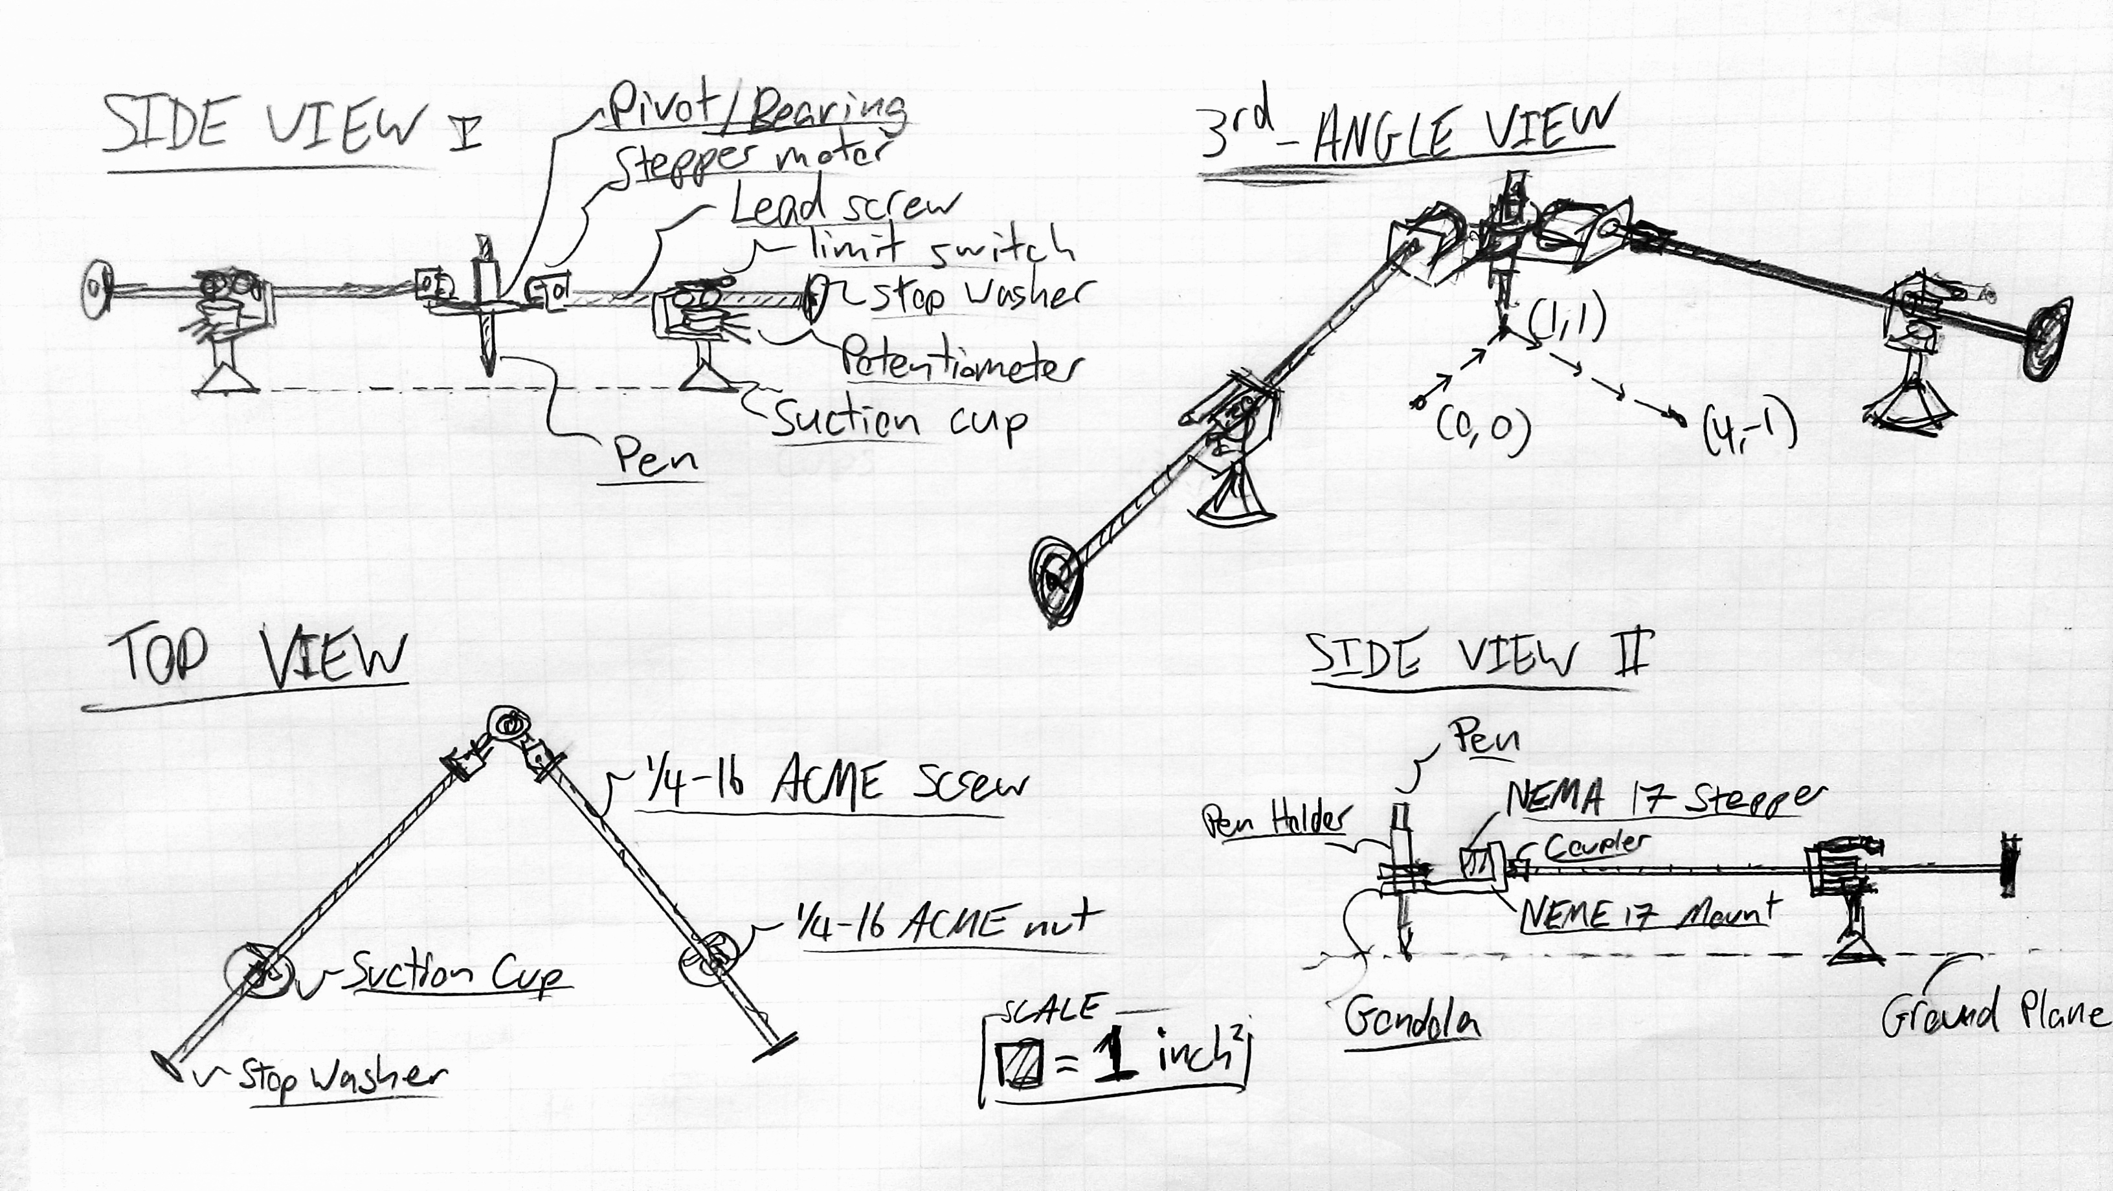
Sketch of Product

Slide 4
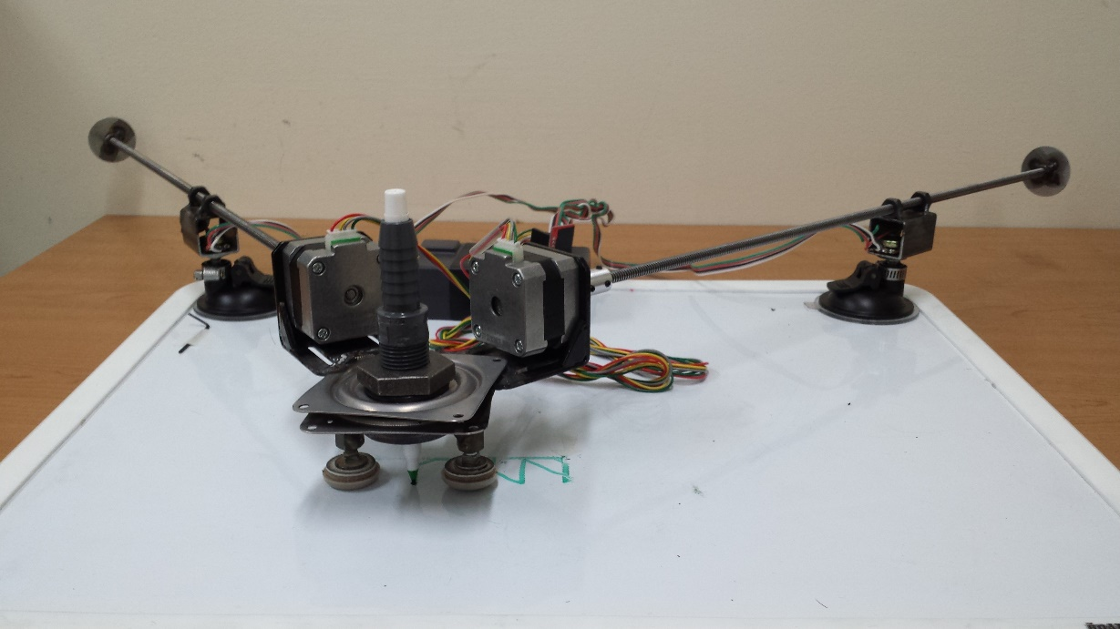
Product
Computer Numerical Control Plasma Cutter
Rather than using an actual plasma cutter a pen/marker will be used as its simulate.
The design will be less expensive than a typical CNC plasma cutter.
The design for the plasma cutter’s mechanism will be triangular rather than rectangular allowing it to be less rigid and therefore portable.

Slide 5
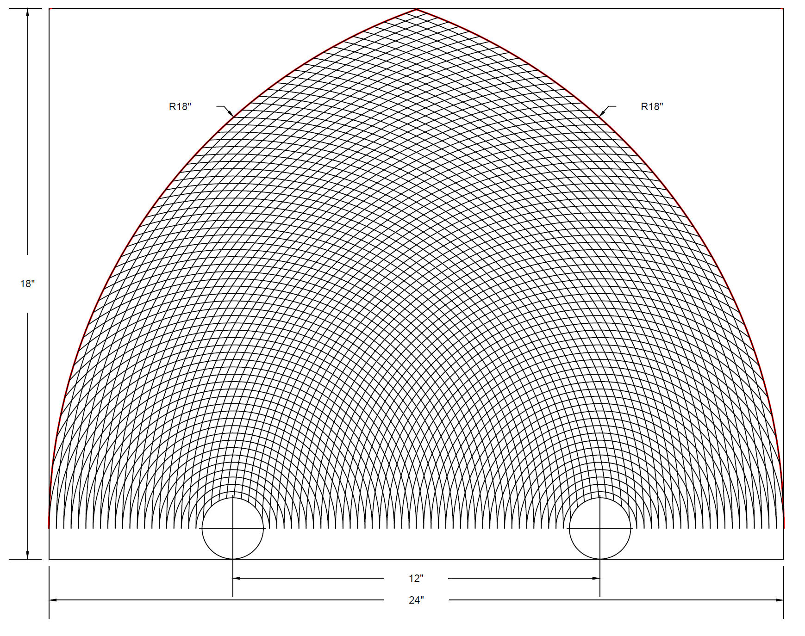
Cone of Resolution - 1
Radii
Each Lead screw can sweep up to a radius of 1.5 ft.
Resolution
Step size = 2% of the distance between the suction cups

Slide 6
Line Algorithm
Calculates new coordinates for the four optional directions.
Options: Motor A in, Motor A out, Motor B in, Motor B out.
Check each option to determine which brings you closer towards the target coordinate.
Of those options, select the option that stays closest to the line between the initial and target coordinates.

Slide 7
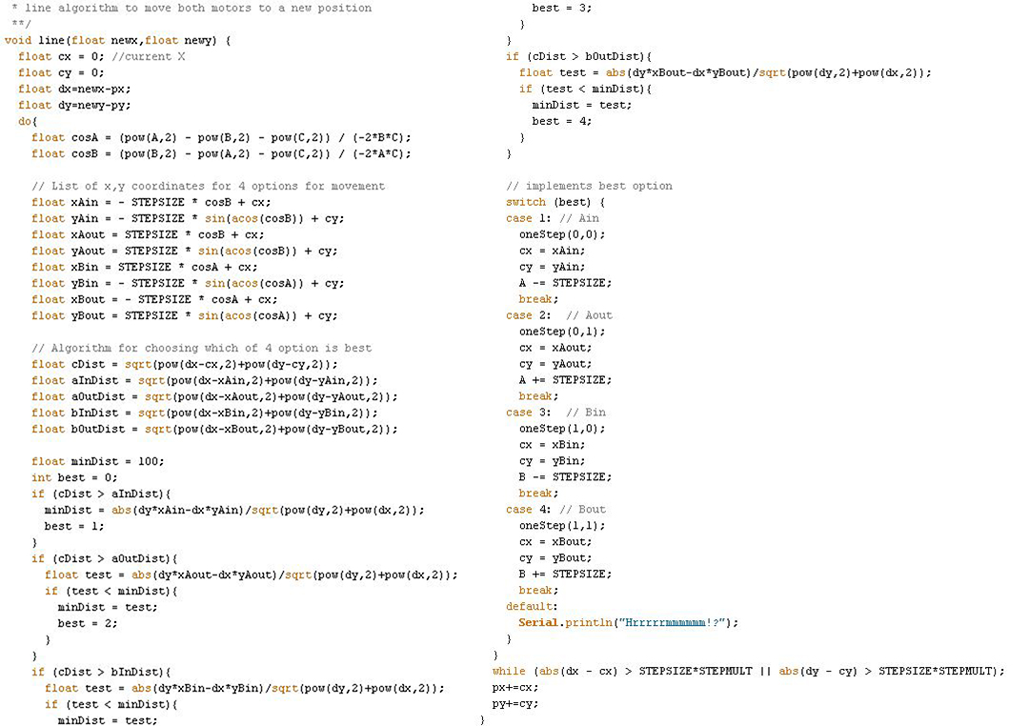
Line Algorithm Code

Slide 8
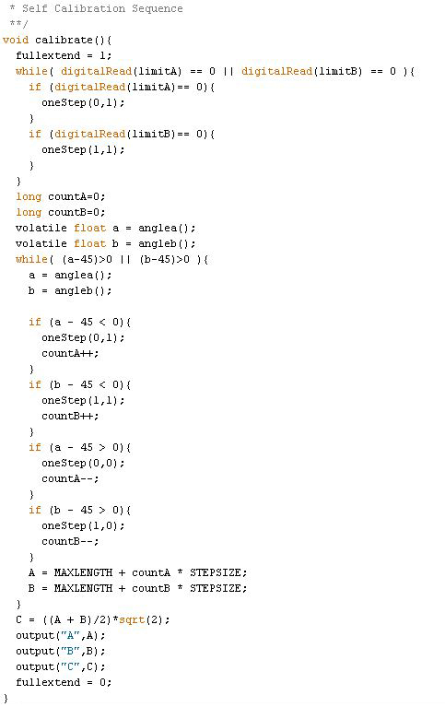
Calibration Algorigthm
Extend both lead screws to their maximum length.
Continually retracts both lead screws until they form a 45-45-90 triangle.
At this position, the coordinates are initialized to (0,0)

Slide 9
Parts & Cost

Slide 10
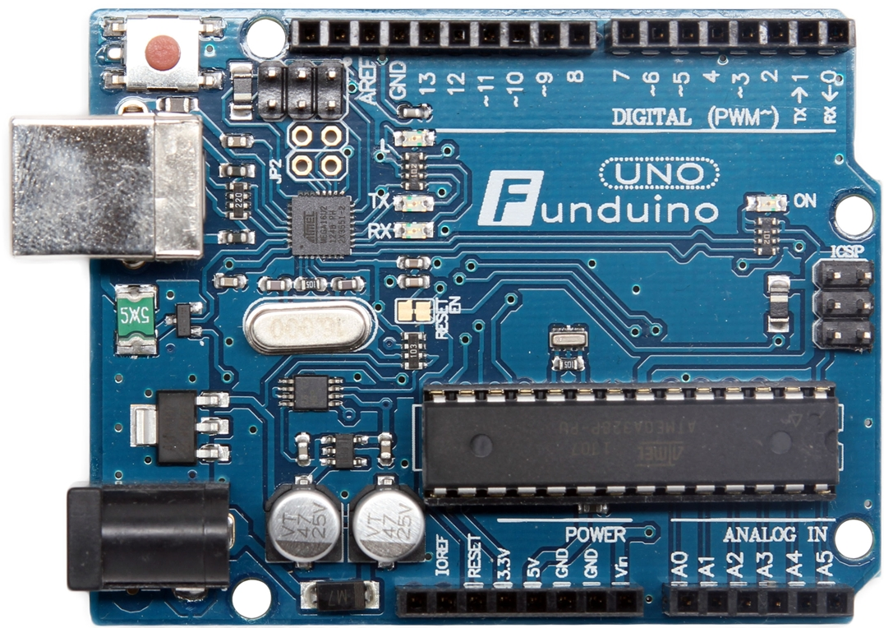
MicrocontrolleR
We are going to use the Funduino Uno R3, which is functionally identical to the Arduino Uno

Slide 11
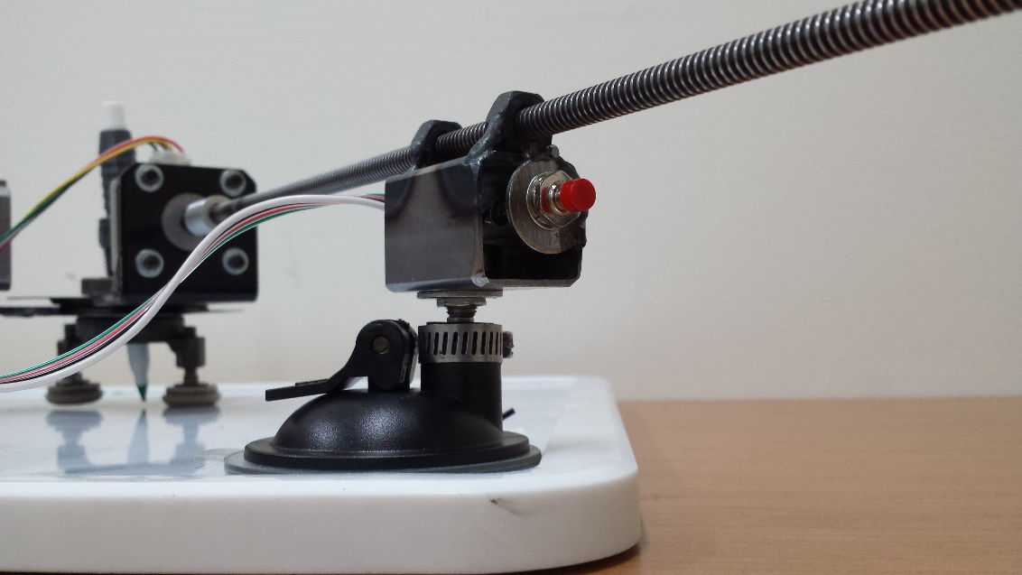
Mechanisms to Prevent Damage
Two limit switches are used to tell the program to stop feeding out the lead screw to ensure that it does not fall out of the mounting nut.
Emergency Switch to disable motors

Slide 12
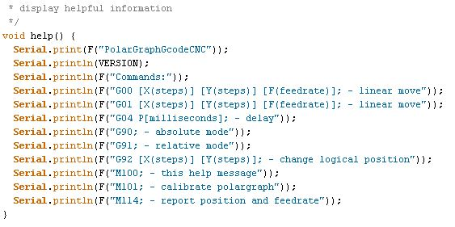
Serial Interfacing
Arduino communicates via Serial Interface.
Uses a parsing algorithm to take in lines of G-code and tells the G-code sender to wait until current action is completed.
In turn, G-code sender waits for “handshake” from the Arduino to enter next line of code.

Slide 13
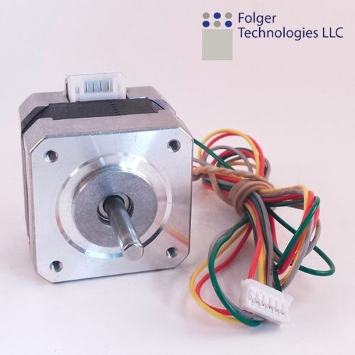
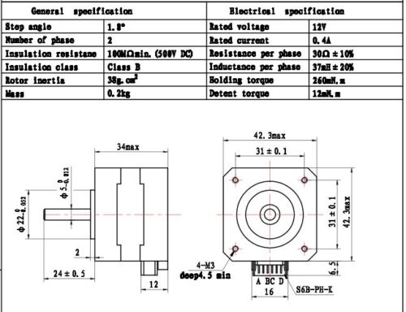
Actuator
NEMA17 17 Stepper Motor

Slide 14
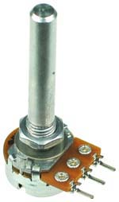
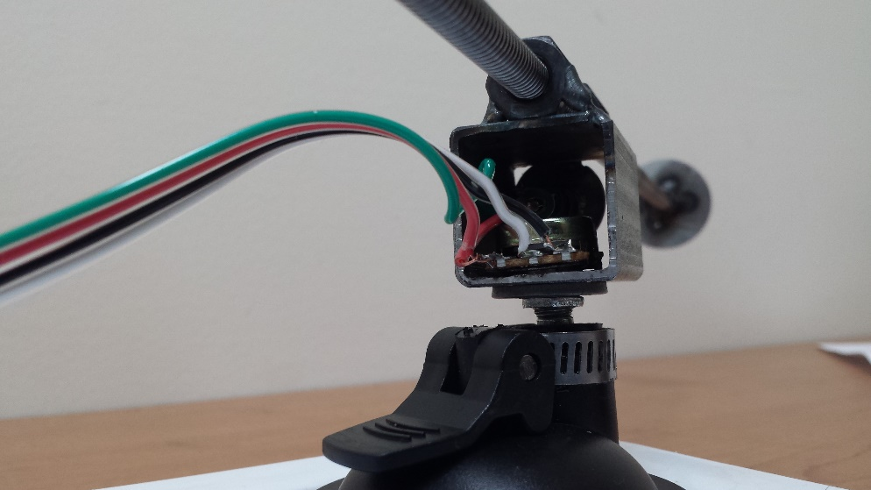
Analog/Digital Sensors
1k Linear Taper Rotary Potentiometer
Limit Switch

Slide 15
Easy Driver – NEMA 17 Stepper Motor

Slide 16
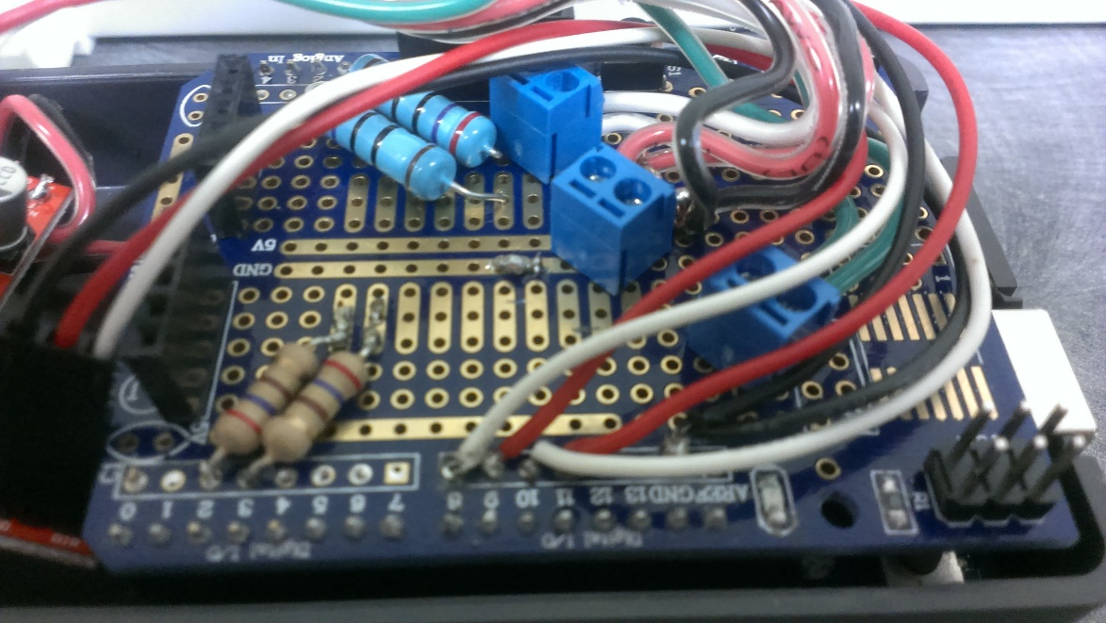
Circuitry

Slide 17
fLOWCHART

Slide 18
Demonstration

Slide 19
Pros vs. Cons
Pros
Lower Cost than traditional CNC Plasma Cutter
Triangulation provides the rigidity that would otherwise have to be provided by a robust frame
By using suction cups to mount it, the device becomes portable and multi-purpose
Cons
Resolution falls off outside of ideal work area
Cannot constrain a device which provides force orthogonal to the plane it works on.
Relies on gravity to hold it down

Slide 20
Other Applications

Slide 21
Questions?

